Slide 1

Real-Time Surveillance System for Detecting Unauthorized Garbage Dumping Using Pose Estimation and LSTM
D15
Guided by,
Ms. Remya VS
(am.en.u4cse22311) -Adithya Krishna J (am.en.u4cse22316) Bharadwaj Kesav P (am.en.u4cse22325) Kasinadhan S (am.en.u4cse22343) Pranav P

Slide 2
Outline
Introduction
Objectives
Workflow Diagram
System Design
Result Analysis (max 3 slides)
Remaining work & GitHub link
Reference
2
Project title

Slide 3
Introduction
Problem Statement:
Urban areas face serious challenges due to unauthorized garbage dumping.
Traditional CCTV systems only record footage and require manual monitoring.
Existing automated systems focus on object detection rather than understanding human behavior.
This project proposes a behavior-based intelligent surveillance system that uses:
Pose Estimation (MediaPipe)
Temporal Modeling (LSTM)
Real-time Action Classification
The system analyzes human motion patterns over time to detect illegal dumping activities accurately.

Slide 4
Objectives
S8 Objectives
LSTM-Based Temporal Action Recognition for Garbage Dumping Detection
Multi-Frame Motion Pattern Modeling for Improved Accuracy
Robust Real-Time Surveillance Pipeline Integration
Quantitative Performance Evaluation using Precision, Recall & F1-Score
Research-Oriented Validation and Publication Preparation
S7 Objectives
Real-Time Human Pose Estimation using MediaPipe
Skeleton-Based Action Feature Extraction
Detection of Bending, Carrying and Dropping Actions
Intelligent Alert Generation for Unauthorized Dumping
Prototype Development for Smart Surveillance

Slide 5
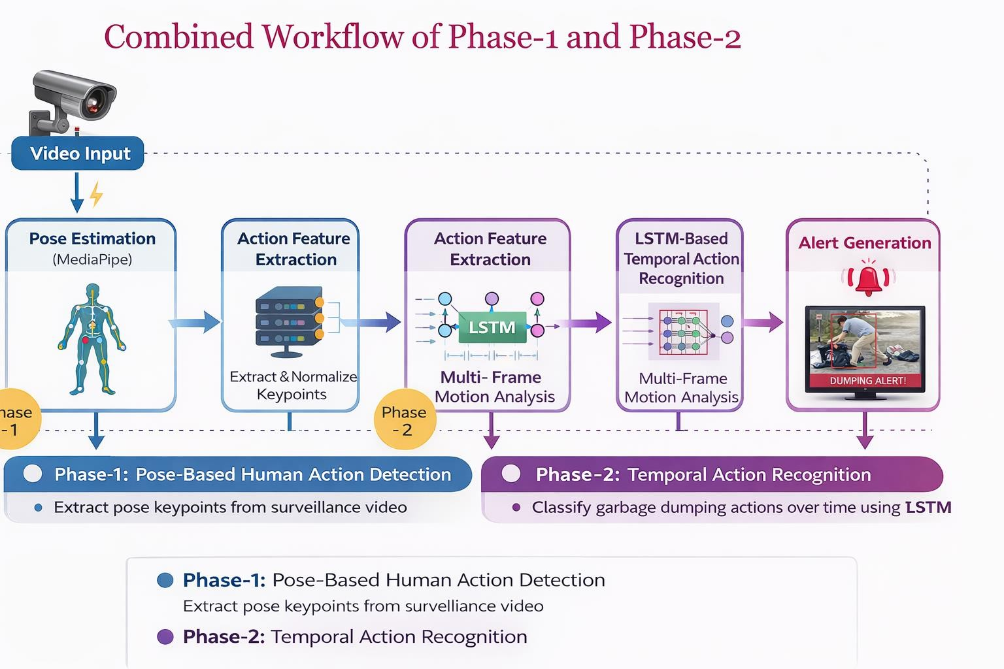
Workflow Diagram

Slide 6
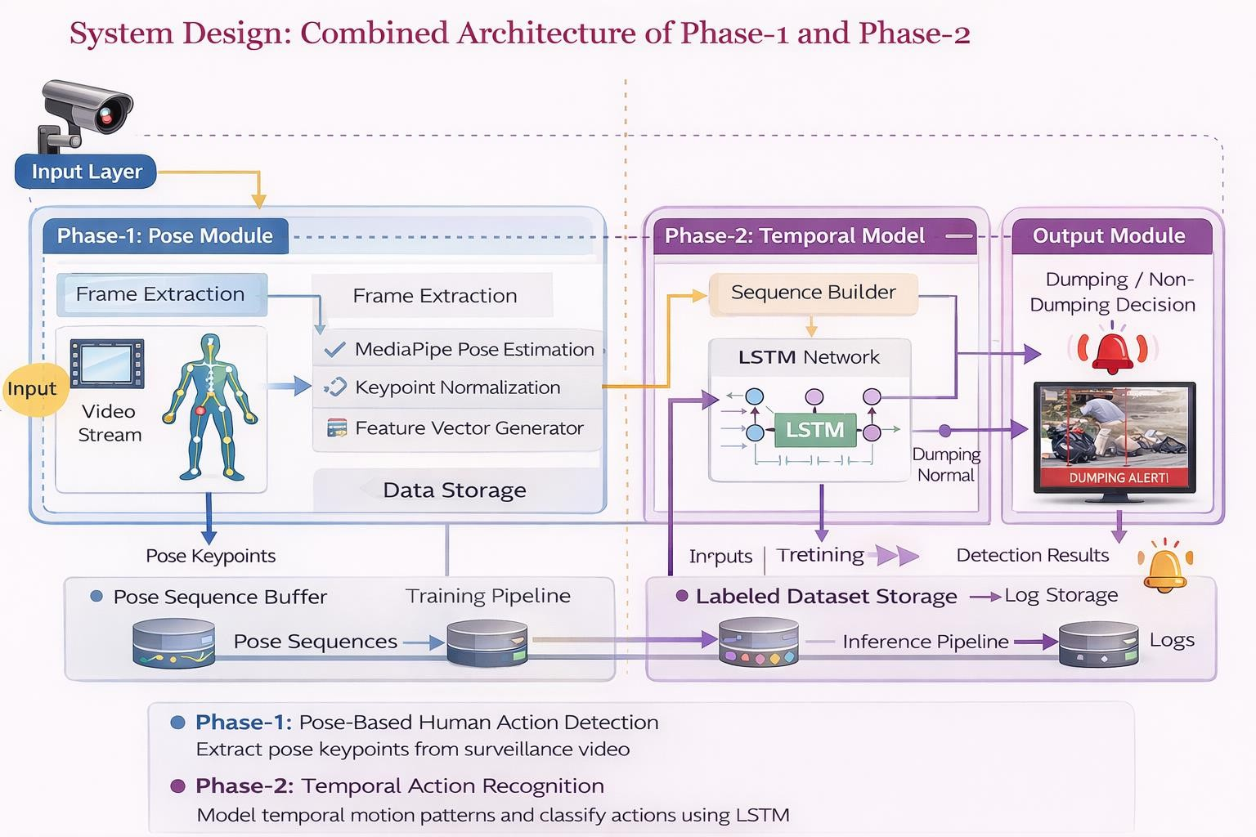
Design Diagram
6

Slide 7
Result Analysis
Experimental Setup & Dataset
Experimental Setup
Language: Python
Framework: TensorFlow / Keras
Pose Extraction: MediaPipe
Sequence Length: 34
Classification Type: Binary
(Dumping vs Non-Dumping)
Dataset Details
Custom-collected surveillance videos
Classes:
Class 0 → Normal Activity
Class 1 → Garbage Dumping
Data Preprocessing:
Frame extraction
Pose keypoint normalization
Sequence generation
Train-Test Split: (e.g., 80:20)
Why Custom Dataset?
No public dataset specifically for illegal garbage dumping
Real-world surveillance simulation
Privacy preserved (only skeletal keypoints used)

Slide 8

Result Analysis
Performance Metrics Evaluation Metrics Used
Accuracy
Precision
Recall
F1-Score
Confusion Matrix
Current Results (Based on Given Metrics)
Confusion Matrix Interpretation
Model correctly identifies most normal actions.
Limited detection of dumping class.
Class imbalance affects performance.
Metric | Value
Accuracy | 86%
Precision (Class 0) | 0.86
Recall (Class 0) | 1.00
F1-score (Class 0) | 0.92
Class 1 Recall | 0.00 (needs improvement)

Slide 9
Result Analysis
Performance Analysis s Observations Strengths
High accuracy for normal activity detection
Temporal modeling reduces random false
alarms
Real-time inference achievable
Limitations
Small dataset size
Class imbalance problem
Occlusion and lighting affect pose extraction
Improvement Plan
Increase dumping samples
Apply data augmentation
Tune LSTM hyperparameters
Explore GRU / ConvLSTM comparison
Balance dataset
G

Slide 10
Remaining work
Item | Time required | Completion date(tentative)
Module name
Module name
. . .
Paper writing
GitHub link
Provide the github link to the project repository

Slide 11
Reference

